Slide 1
GeM Pool Account (GPA)
Challan Model
Designed by GeM Training Team

Slide 2
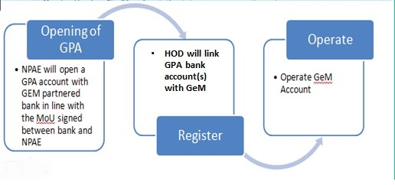
Introduction to GPA
A special purpose bank account opened, operated and controlled exclusively by each NPAE (Non-Public Financial Management System (PFMS) Agencies/Entities).
The GeM pool account can be opened in any of the Banks integrated with GeM.
The Buyer would credit the projected value of contracts/supply order into the account before placing an order on GeM.
The Payments to the suppliers would be made from the GeM pool account post successful supply and acceptance of goods and services on GeM Portal.

Slide 3
Role of Bank/NPAE/GeM
Bank – Operate GPA account as per MoU signed with NPAEs in accordance with GeM Terms and Conditions.
NPAE –
Opens and operates GPA
Maintains projected value for active transactions in GPA account opened by NPAE
In Adherence to MoU, SLA for buyers have been defined for timely payments
GeM –
Process transactions subject to requisite credit in GPA
Provide real time information/instruction online to both bank and NPAE subject to the transactions.
Assure compliance with SLA including timely payment.

Slide 4
Opening and Maintaining GeM Pool Account
The NPAE would nominate and authorize a Nodal Officer for GeM to open and authorize the “GeM Pool Account (GPA)”.
The NPAE can select any bank(s) which has been enabled for GPA integration with GeM.
The NPAE will open the GPA, which will be utilized by buyer through the GeM platform owned and maintained by GeM SPV, as per SLA, and solely for procurement of goods and services on GeM.
The terms and conditions of procurement on GeM will be part of the operations manual between bank and the NPAE.
Real time details of all operations of the account will be shared by the bank, in mutually accepted format with the NPAE.
The NPAEs are not permitted to use GPA for any payment/operation outside GeM. Any withdrawal / transfer by the NPAE from this account, except for payment to the supplier, would be permitted only in case of Order cancellation, Order rejection and Unused blocked amount on order completion

Slide 5
GPA - Models
The GeM Pool account has 2 Models
Challan based Model
Non-Challan Model
Challan model
Funds are transferred in The GeM Pool account after the demand/intent has been finalized
A Challan is generated on GeM using which the Buyer funds the required amount in GeM Pool account.
Non Challan Model
A Floating amount based on Procurement forecast is maintained by Buyer in Pool account
No challan is generated as pool account is already funded.

Slide 6
Challan Model
Designed by GeM Training Team

Slide 7
Challan Based GeM Pool Account
A challan would be generated on GeM Portal before the order can be placed. The Buyer would fund the Pool account with the projected value of the order before order placement.
The credit process in Challan based GeM pool account differs for products & service orders as below.
Product Orders
Buyer will make arrangements to credit 100% of the projected order value before the order creation.
Services Orders
Buyer will make arrangements to credit funds in GeM Pool Account as per the services billing cycle. The funds will be equal to projected value of service order as per services billing cycle.

Slide 8
Registration of Challan Model By NPAE
Once an NPAE primary user is registered successfully on GeM, he would need to add the GPA details to ensure seamless payment.
Primary user will be required to register the secondary user as a PAO in GEM & need to enter the payment authority code in GeM.
If Primary user does not have the payment authority codes the same can be generated on GeM portal.
Login on GeM Portal (Primary User)
Open ‘My profile’
Select ‘GPA’ as Payment Mode
Specify GPA account Details and Save
Login on GeM Portal (Primary User)
Register Secondary Users (PAO)
Link the GPA account to PAO
Specify the PAO code or Generate a new code

Slide 9
GPA On-boarding by Primary User
Challan Model
Designed by GeM Training Team

Slide 10
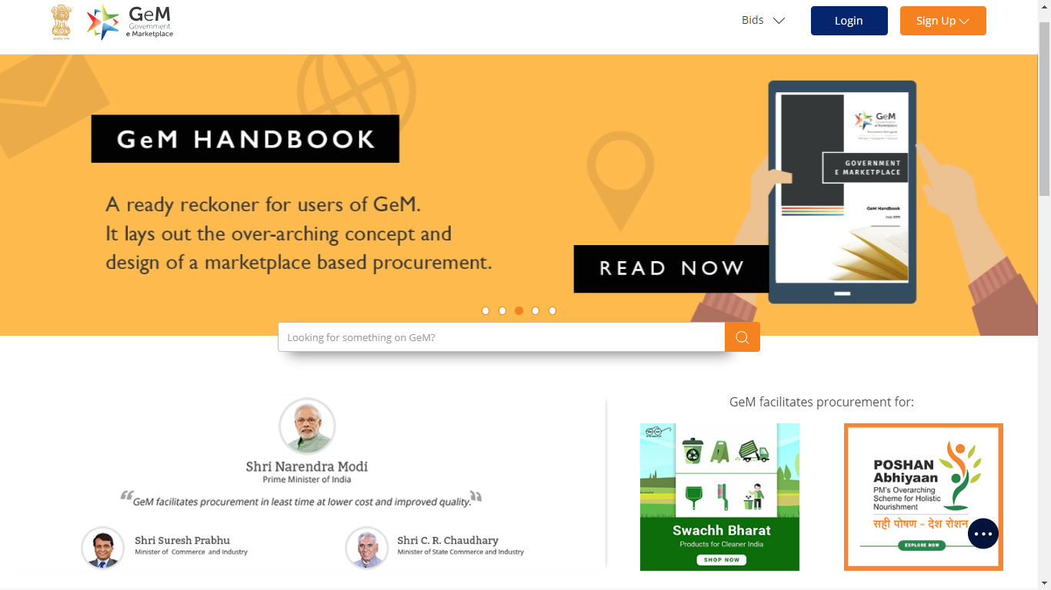
Open www.gem.gov.in
5 DECEMBER 2018
Designed by GeM Training Team

Slide 11
5 DECEMBER 2018
Designed by GeM Training Team

Slide 12
Designed by GeM Training Team

Slide 13
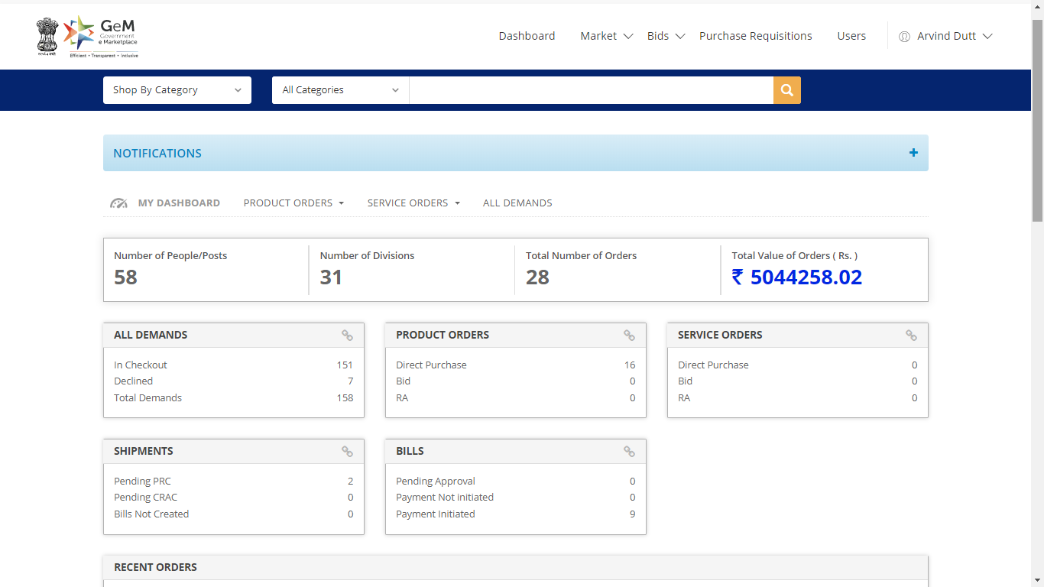

Slide 14
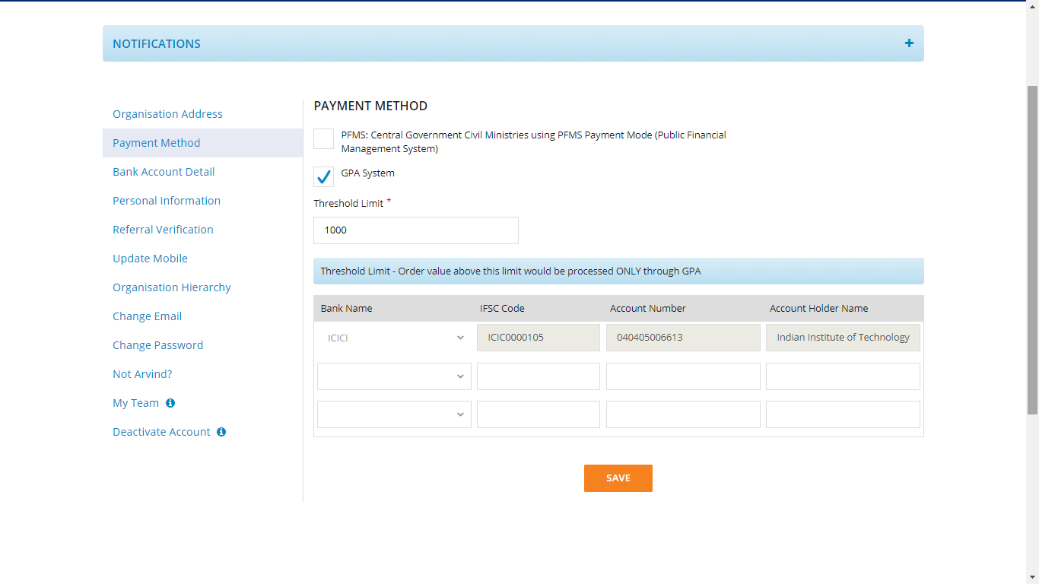

Slide 15
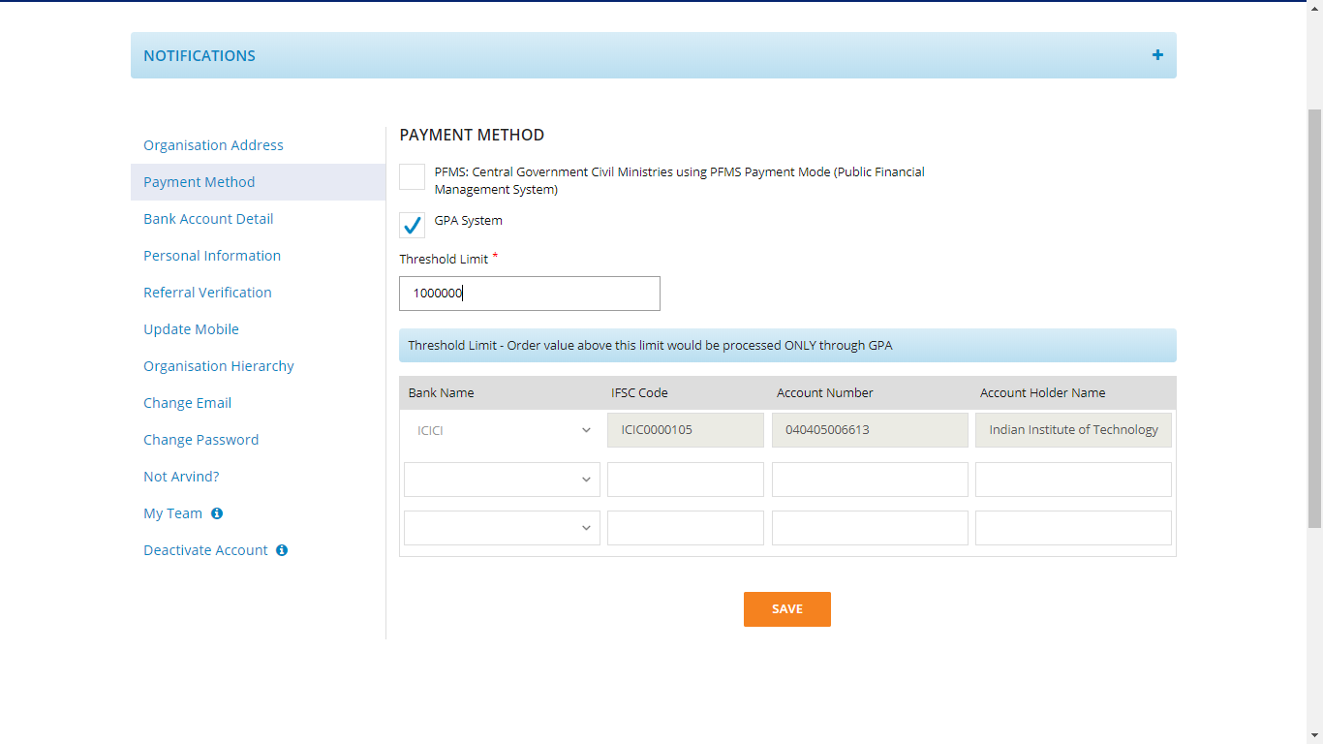
Threshold Limit: Threshold limit refers to the minimum amount selected by Primary user for an order/service by an entity for GPA. Over and above the threshold limit the order/service will be processed through GPA only and below that GPA is optional. Threshold Limit can be selected between 0-10 lacs

Slide 16
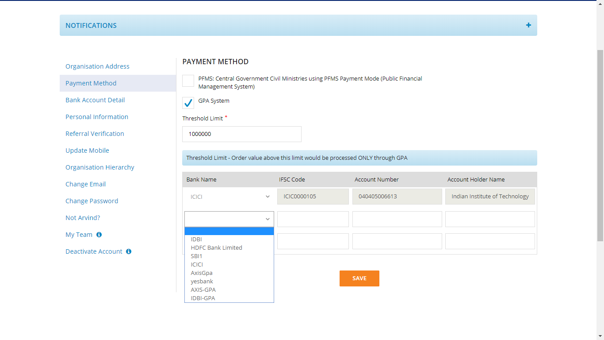
Primary user to provide GPA bank account along with IFSC code

Slide 18
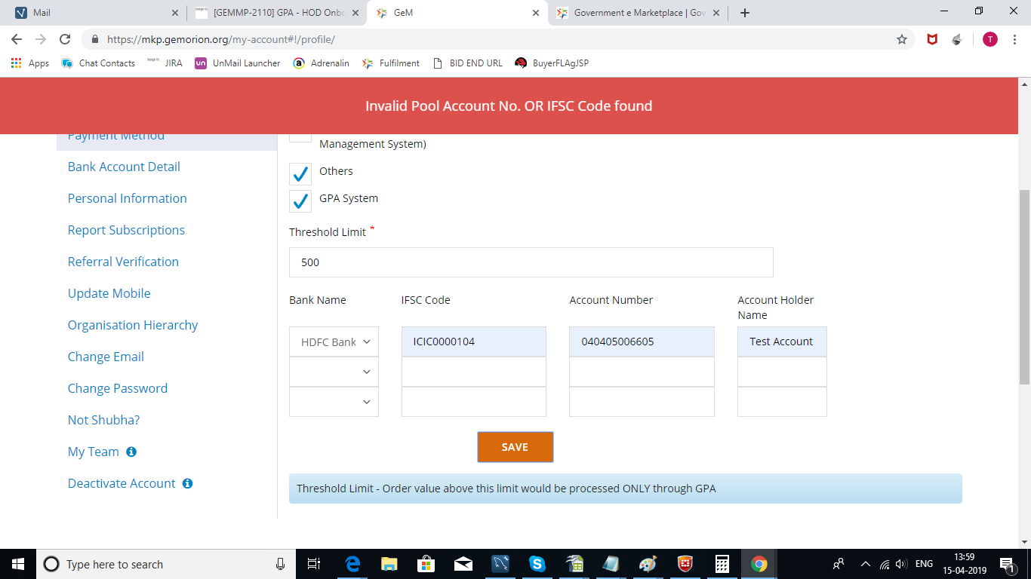
Error message in case Primary user enters Invalid Pool account or IFSC code.

Slide 19
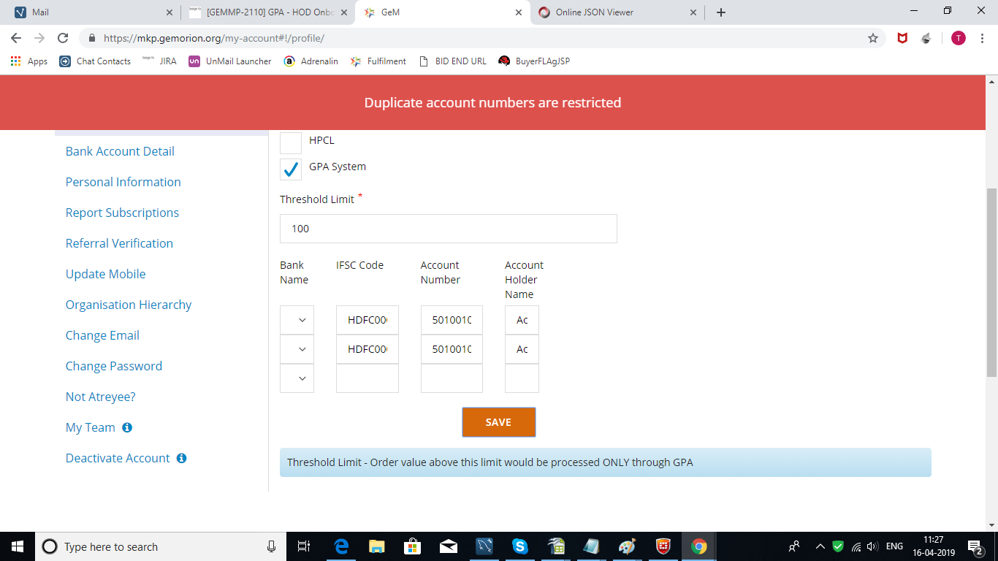
Primary user must be restricted to enter same account information twice.

Slide 20
User creation by Primary user
PAO Code generation – Challan Model
Designed by GeM Training Team

Slide 22
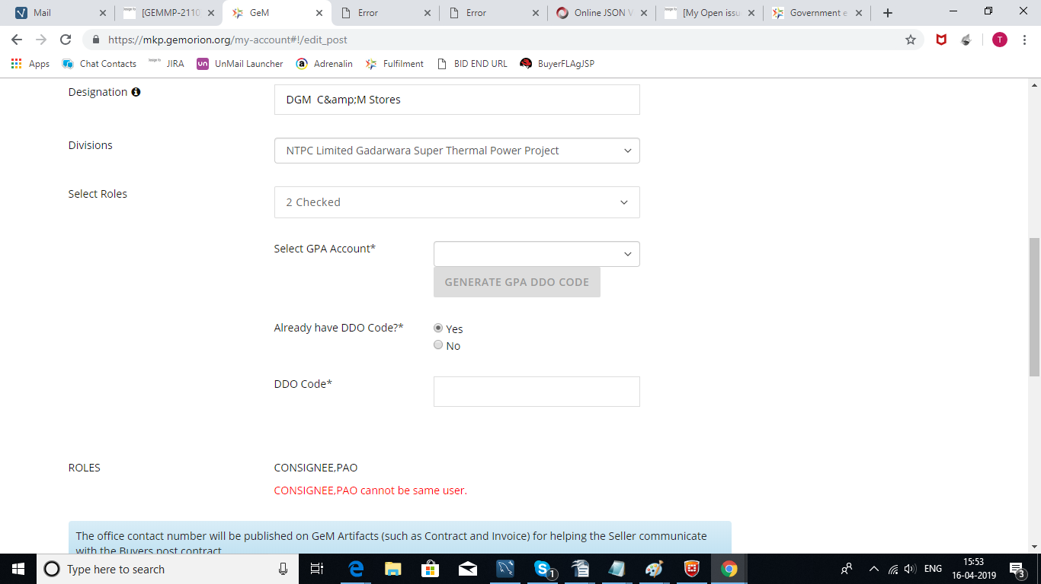
If Primary user already has a PAO code ,must select yes and provide the code

Slide 23
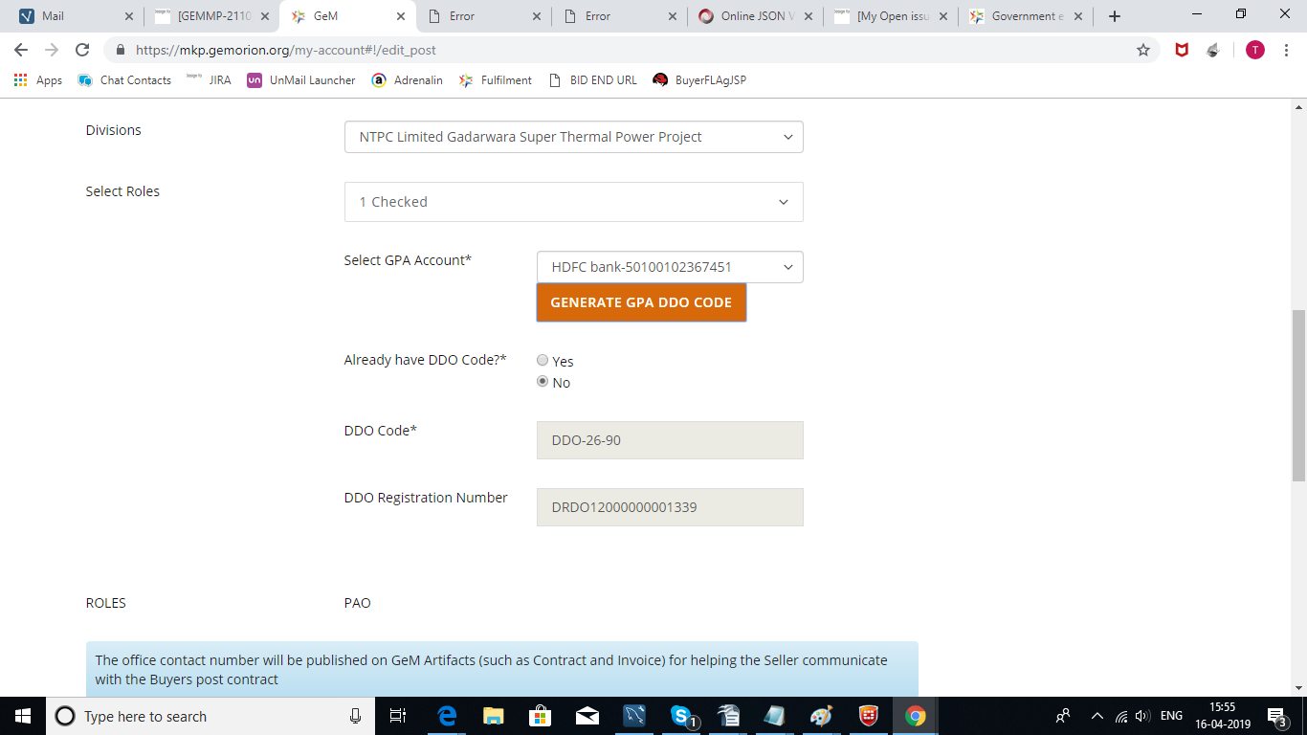
PAO CODE
If Primary user don't have PAO code ,must select no and click on Generate GPA PAO Code

Slide 24
Challan generation and Fund Blocking by Buyer
Challan Model
Designed by GeM Training Team

Slide 25
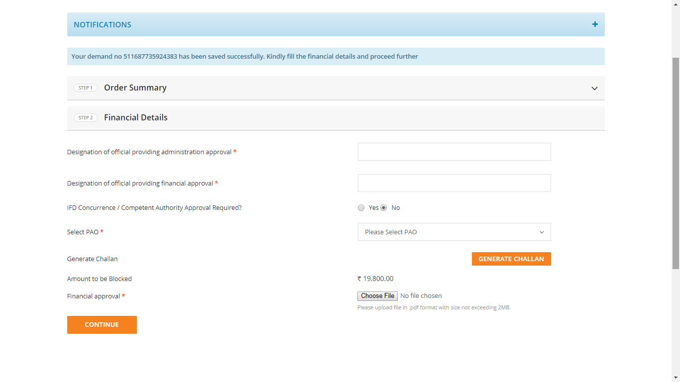
Once L1 has been selected via Direct purchase or Award of Bid/RA, the Buyer would specify the Financial details. Please visit LMS for training video on Order Placement.

Slide 27
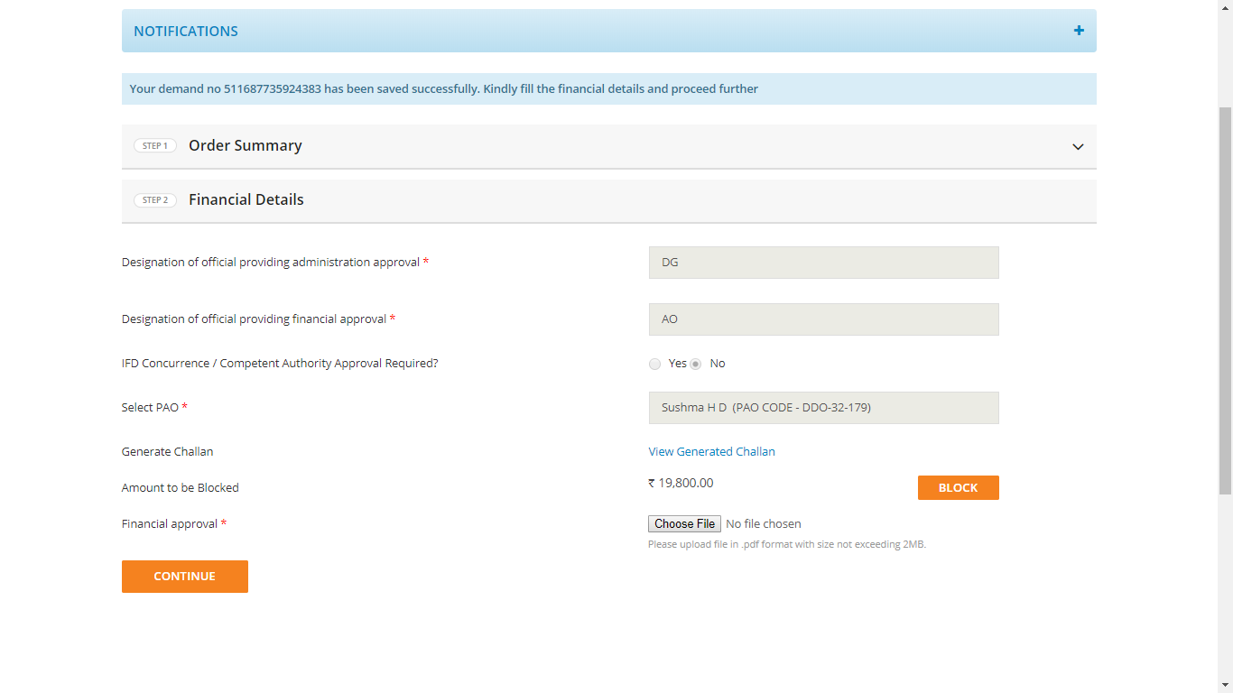

Slide 28
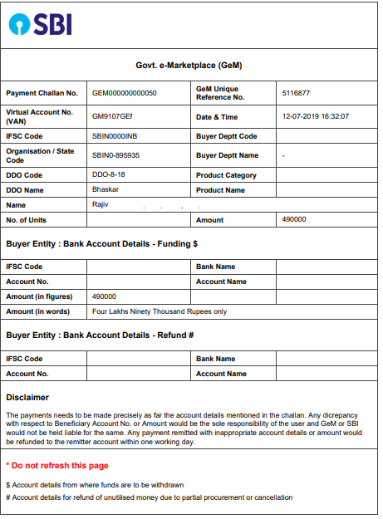

Slide 29
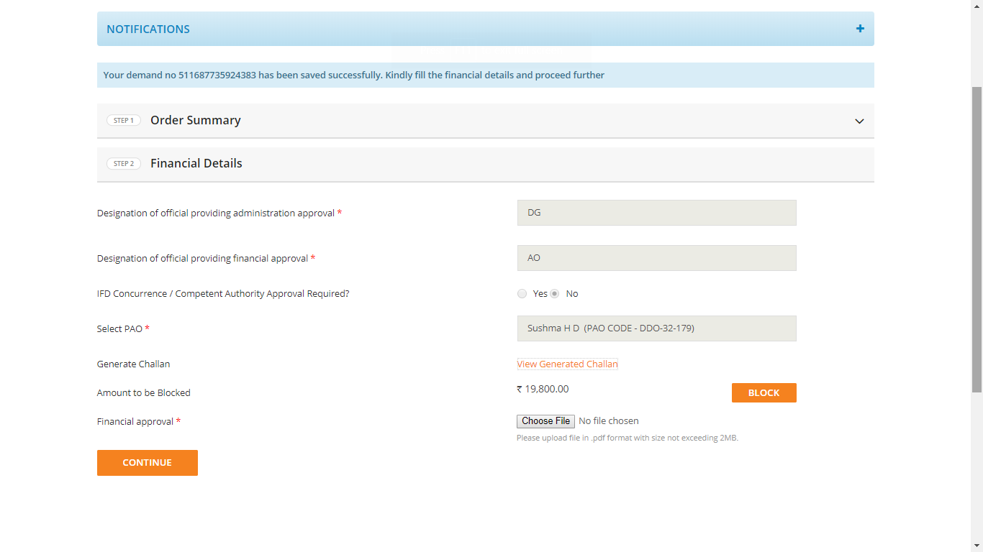

Slide 30
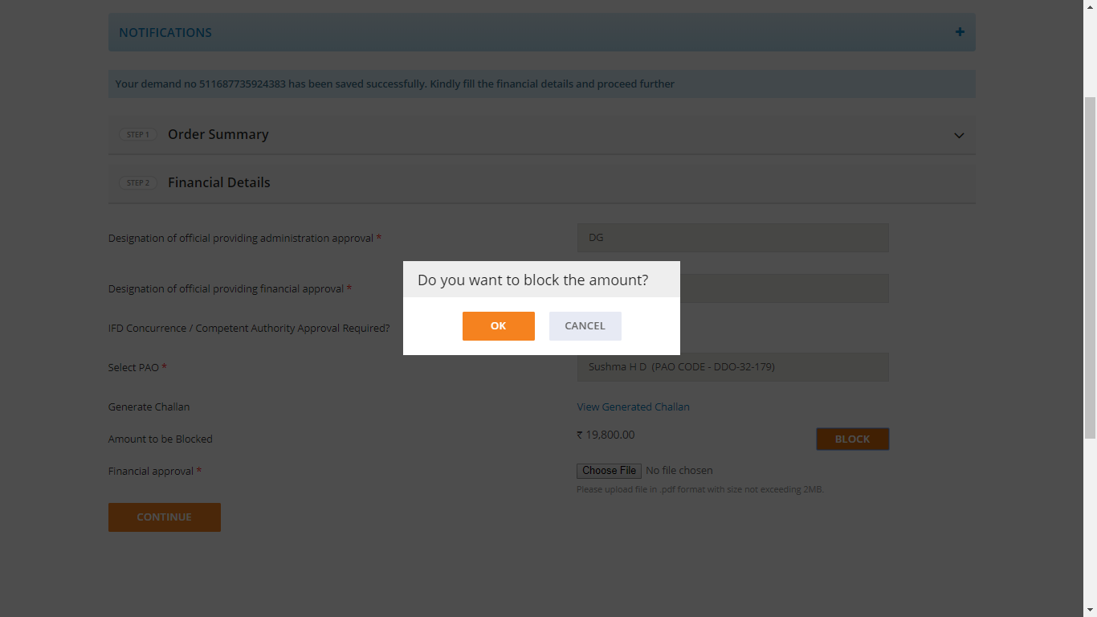

Slide 31
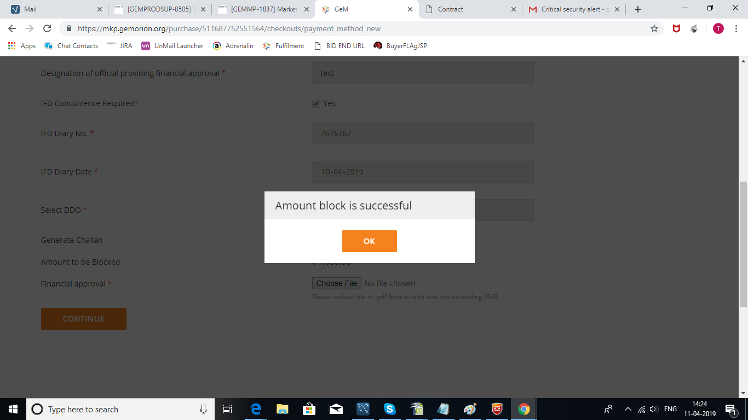

Slide 32
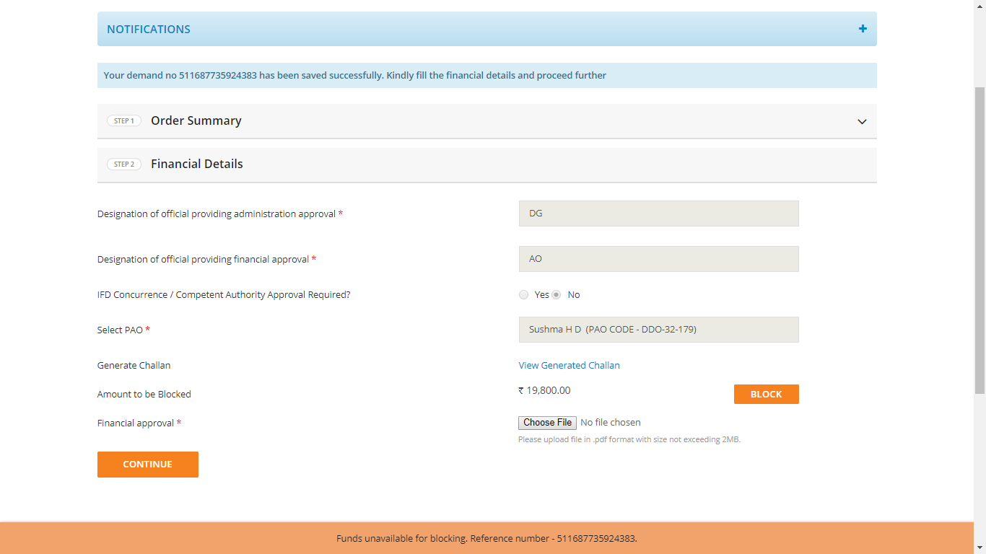
Error message when funds are not available in the account

Slide 33
Payment to supplier post CRAC generation
Designed by GeM Training Team

Slide 34
Payment to Supplier
The payment process is triggered post the successful supply, acceptance and online issuance of CRAC by the consignee as per the timelines prescribed.
CRAC Generated Successfully by Consignee
Bill to be created by Buyer as per CRAC
Paying authority will process the payment through GPA
Payment credited to the sellers account

Slide 35
Payment to Supplier
In case, even after 10 days of issue of CRAC, the buyer has not initiated the payment process
A payment trigger will be automatically generated
80% of the consignment value deduced by the system as per CRAC
Intimation will be sent to the HoD, buyer and payment authority for GeM, regarding the release of payment
If failed, after 35 days the same will be released to the supplier automatically through an alert to the bank by the GeM Platform
The residual payment is to be processed by the buyer within 35 days after adjusting for any statutory deduction and damages,
Payment credited to the sellers account

Slide 36
Bill summary page for GPA
Designed by GeM Training Team

Slide 37
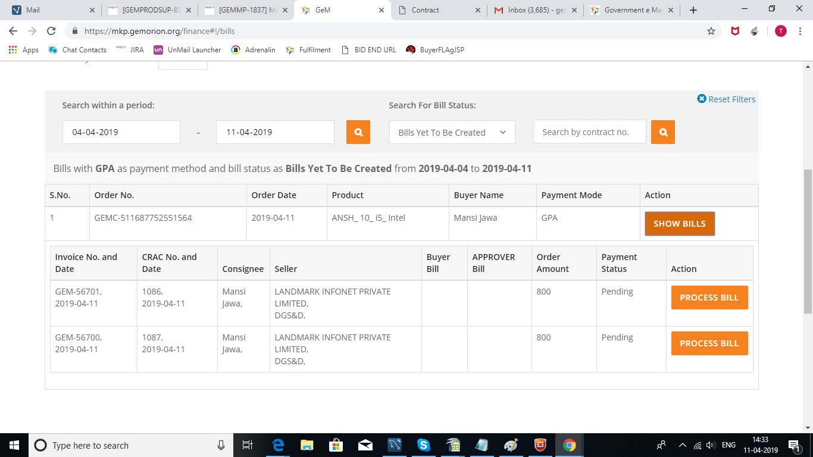
Bill Summary page for GPA

Slide 38
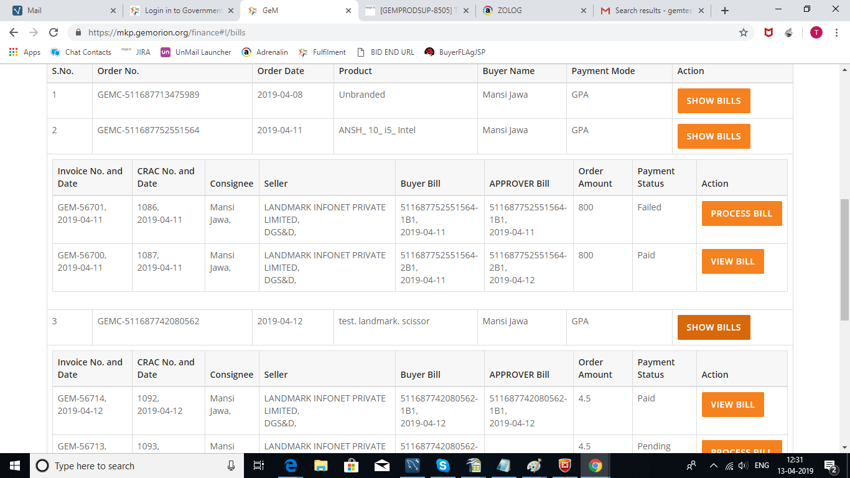
Payment status of the bills marked as 'Paid'/ 'Failed'

Slide 39
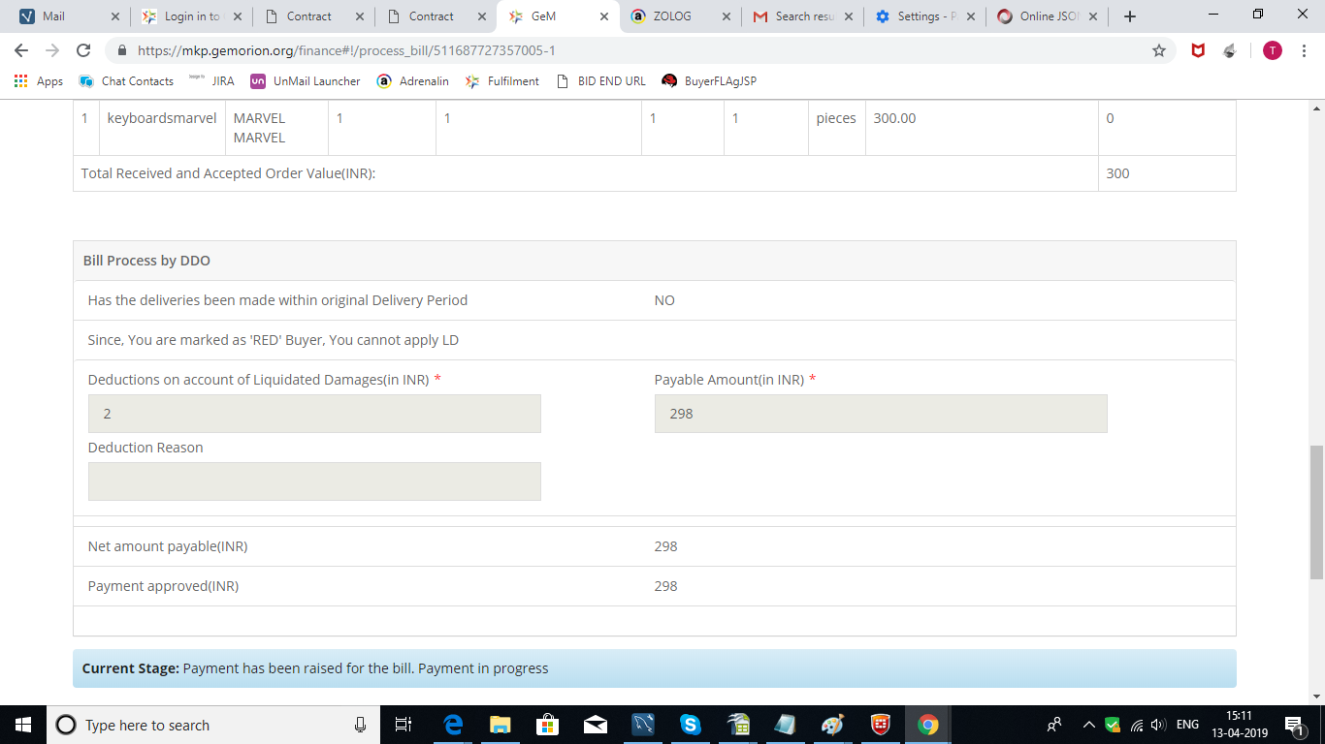
Payment instruction of the bill in case LD is applied

Slide 40
Designed by GeM Training Team
Designed by GeM Training Team

